Slide 1
After Sales Project Specialist
December 2022

Slide 2


Title slide
Challenge
Our After Sales team is responsible for a huge part of our partner lifecycle. Made up of +130 employees across 13 markets, we’ve developed a different approach per each country for the following steps: onboarding, training, growing and retention of our partners. Now it is time to process with specific project that will help to align the processes.
Your Task:
As an After Sales Project Specialist, your first task is to help the After Sales Project Team to understand and identify clusters from our partner base and to plan the migration of them from our old SaaS to the new one.
Please consider:
The Part 1 must be presented in a short speech of maximum 8 minutes.
The Part 2 must be prepared and send by email.
The case has to be completed and sent to me before 3rd January 2023, morning.

Slide 3
Part 1 - Excel
Attached to the email you will find a sample of our partners that need be migrated from the old SaaS to the new one. The file has 3 sheets.
Analyse the sample and divide it into 2-4 clusters to prioritize the partners that need to be moved first.
Define the clusters, the priority to migrate first, and the motivation.
Identify if all the partners can be migrated or not.
Identify if there is potential risk of churn for some partners.
Download the file and prepare max 2 slides to present your strategy, explaining your idea and the Excel formulas applied.
To consider:
Appointments_count field is intended as the count of appointments added by the partner.
Bookings_online field is intended as the count of appointments booked via marketplace (online).
Last_salon_appointment field is intended as the last date of an appointment generated from the SaaS.
Last_online_appointment: field is intended as the last date of an appointment generated from the marketplace.

Slide 4
To consider:
The most important KPI for the company is the: Heavy SaaS, that defines the loyalty of our partners through our product. More appointments are added manually in the calendar, better it will be the partner score and the presence in Treatwell marketplace. This will generate more visibility and more bookings.
Heavy SaaS: ‘>= 40’ appointments per month and last salon appointment date is not “>30” days from today [“2022 - 12 - 08”].
Statistically, salons with a Starter plan use another software than Treatwell to manage their business (with POS, stock/warehouse, etc), so they are using different platforms to work.
Keywords:
Starter: SaaS plan with calendar and statistics
Advance: SaaS plan with calendar, POS, promos and statistics
Premium: SaaS plan with calendar, POS, promos, warehouse and statistics
Id: ID number of the venue
Venue: salon
Reviews: reviews on marketplace profile
Average Rating: online opinion punctuation
Customers count: number of customers registered per salon
accepts_online_payments: the salon accepts online payments
online_payment_only: the salon accepts online payments only

Slide 5
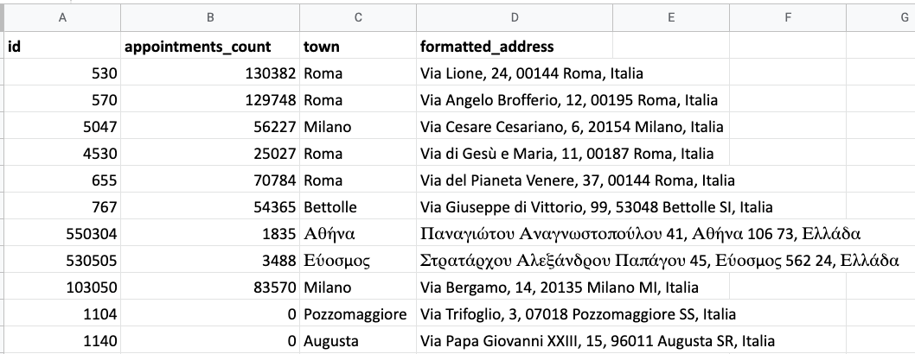
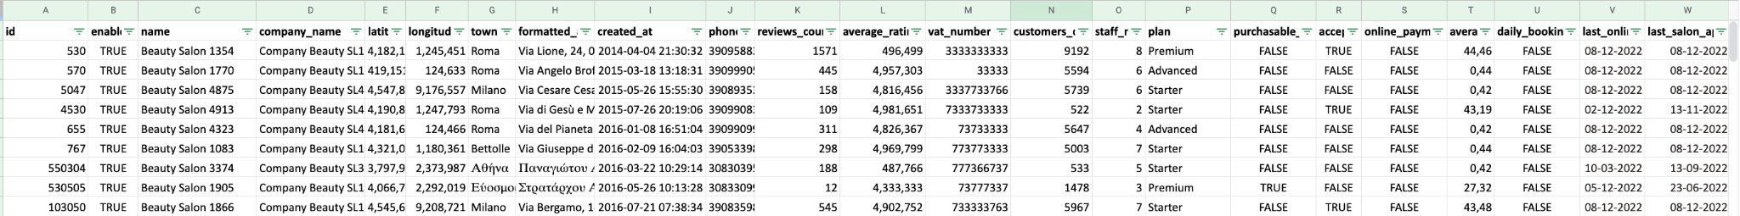
Part 2 - SQL
Based on the Part 1, and considering the tables Venues and Appointments:
Identify the total numbers of partners and the number of partners per plan (Startet, Advanced and Premium)
Identify the number of partner created per month
Count of the Heavy SaaS partners
Please, let us know the SQL language applied in your solution.

Slide 6
FAQs
What is Treatwell looking for in this task?
Do you want to see my thinking as well as my final results?
Will there be questions?
Absolutely, as we are going to ask what you have discovered in the process and the difficulties you have experienced.
We’re looking at your ability to analyse data and proceed with a creation of a possible process or solution.
Yes, we want to understand how you identified the most important data and how you can use it to complete the task/s.
What you need?
How long will I have to present back my work?
How long should I spend on this?
You can use any tool you need to analyse the data. The use of Excel or Drive Sheets mandatory and a tool of presentation for the slides.
Your presentation should be no longer than 8 minutes.
We expect you to spend roughly 2-3 hours

Slide 7

We are committed to creating a fair and valuable hiring process at Treatwell. This task has been created purely for the purpose of recruitment for the After Sales Best Practice Specialist role.
This will not be used for real-life benefit, our intent is only to see how you would apply your skills in a scenario you may face in this position.

Slide 8
Good luck!

